Slide 1
How can AI help disabled people?
Robin Christopherson MBE, AbilityNet
Tamsin Keyes, Headway
Michael Vermeersch, Microsoft
Annie Mannion, AbilityNet (host)
Wednesday 17 April 2024

Slide 2
Welcome
Live captions during the online event – toggle on/off
Additional captions available via streamtext.net/player?event=AbilityNet
Slides, a transcript and recording will be made available: www.abilitynet.org.uk/AIWebinar
Please use the Q&A window to ask questions
Chat function is disabled
Feedback form to ask any follow up questions post-event

Slide 3
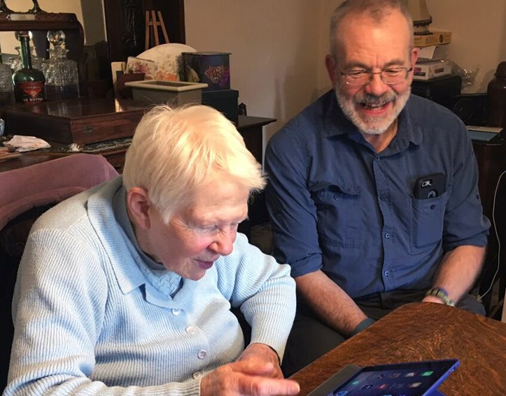
Who are we?
AbilityNet supports people of any age, living with any disability or impairment to use technology to achieve their goals at home, at work and in education.

Slide 4
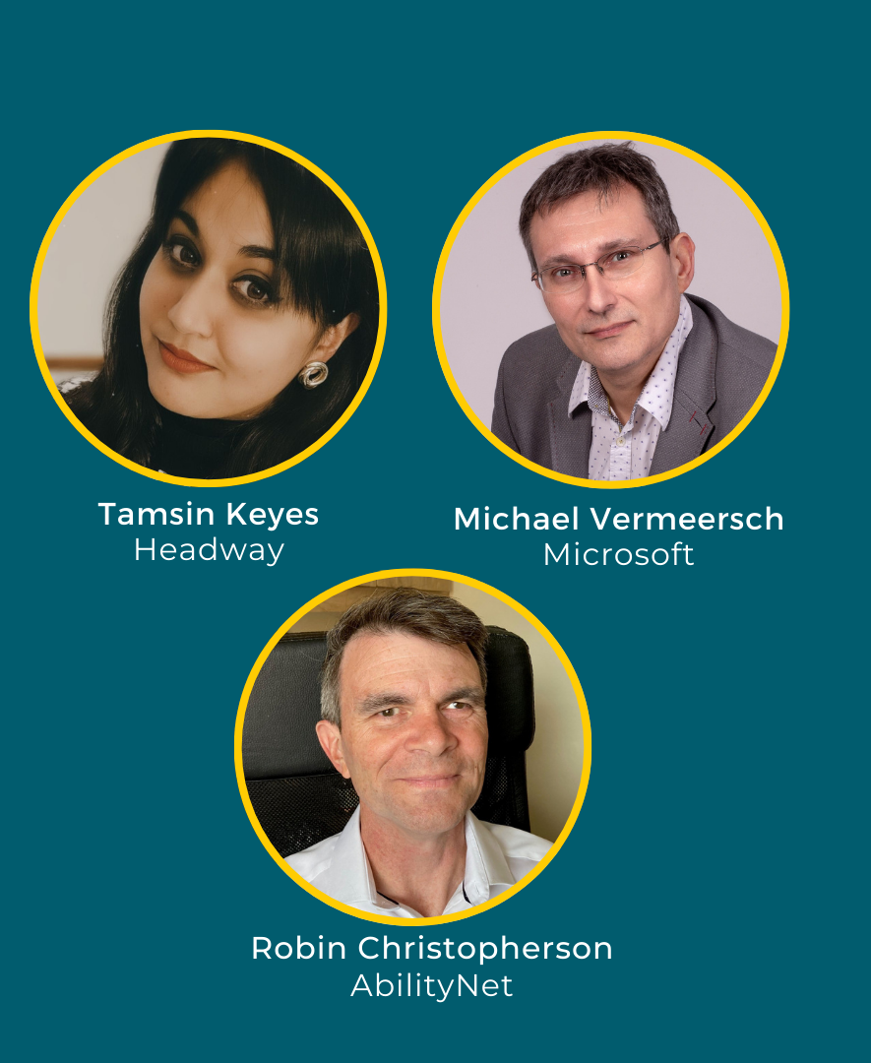
Today's speakers
Robin Christopherson MBE,
Head of Digital Inclusion at AbilityNet
Michael Vermeersch,
Accessibility Go to Market Manager at Microsoft
Tamsin Keyes, Publications and Research Manager at Headway the Brain Injury Association

Slide 5
Poll 1:
How confident do you feel using AI technology?
Very confident
Confident
OK with some devices/sites
Not confident
Not at all confident
NA

Slide 6
Current examples of AI in action: how AI is empowering disabled people
Robin Christopherson, MBE, AbilityNet

Slide 7

Vision
Be My AI
Seeing AI
Google lens – identifying objects/text/handwriting

Slide 8
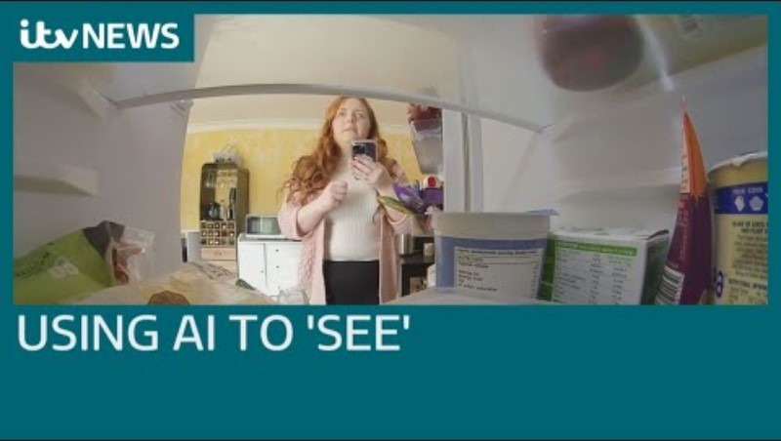
Vision continued…
Be My AI:

Slide 9
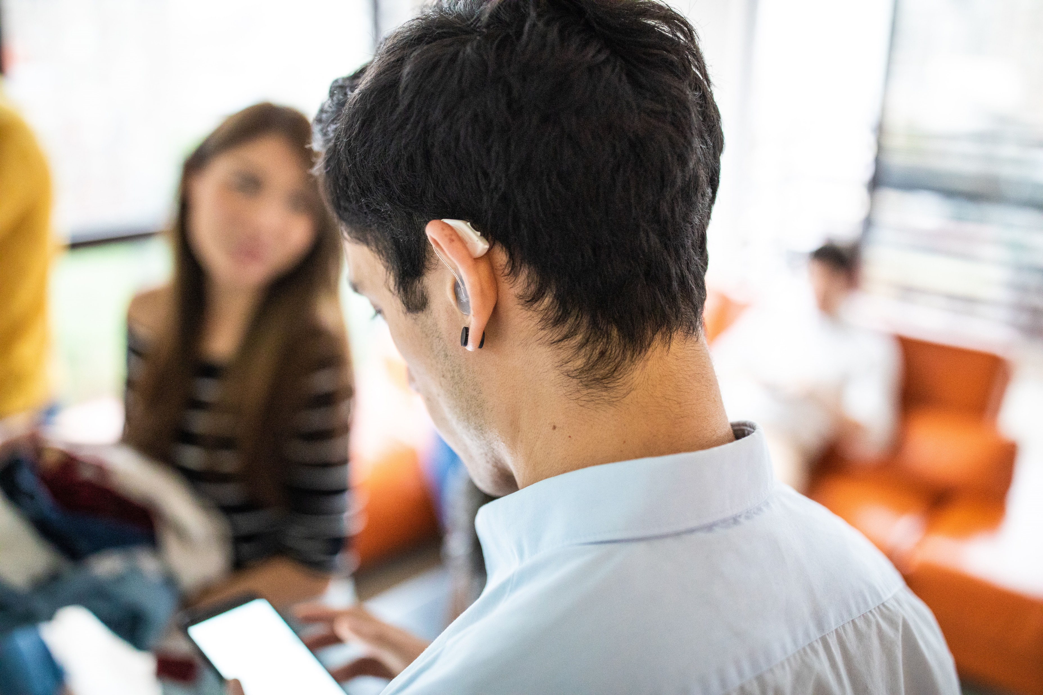
Hearing
Ava/RogerVoice – AI captioning (and translation) transcribe group conversations.
HeardThat - filter out background noises and keep conversations clear
Orka Two – hearing aid that uses AI to continuously balance speech clarity with noise reduction.

Slide 10
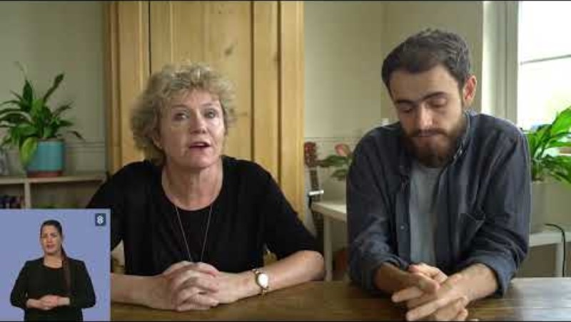
Hearing continued…
Signapse
real-time sign language translator software

Slide 11

Communication
Google:
  Project Euphonia/Relate – AI used to significantly improve speech recognition models to better transcribe a variety of atypical and dysarthric speech
  Project Parrotron - convert speech from a speaker with atypical speech patterns directly into fluent synthesized speech, without an intermediate step of generating text.

Slide 12
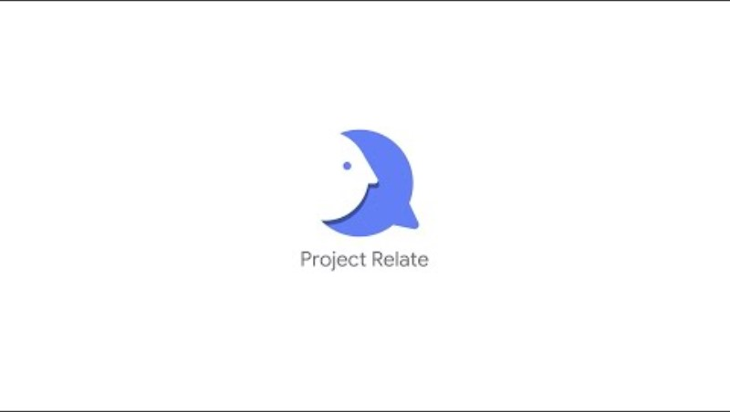
Communication continued…
Project Relate:

Slide 13

Cognitive / Learning
Google lens – AI visual search
Helpicto (Fr) - translate spoken sentences into images to support the understanding and demand of people with cognitive impairment.
Goblin Tools – AI todo list – input a task and it breaks it down into smaller steps.

Slide 14
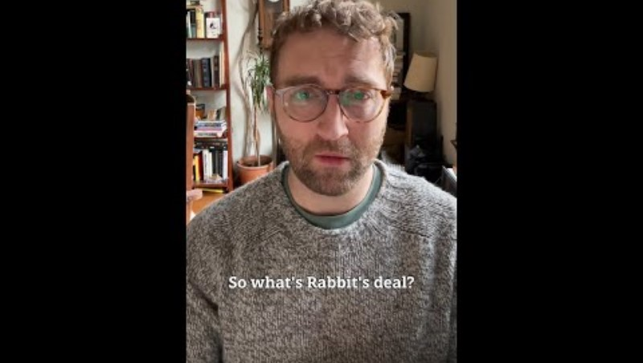
Cognitive / Learning continued
Rabbit R1:

Slide 15
Headway the Brain Injury Association
Tamsin Keyes, Headway the Brain Injury Association

Slide 16
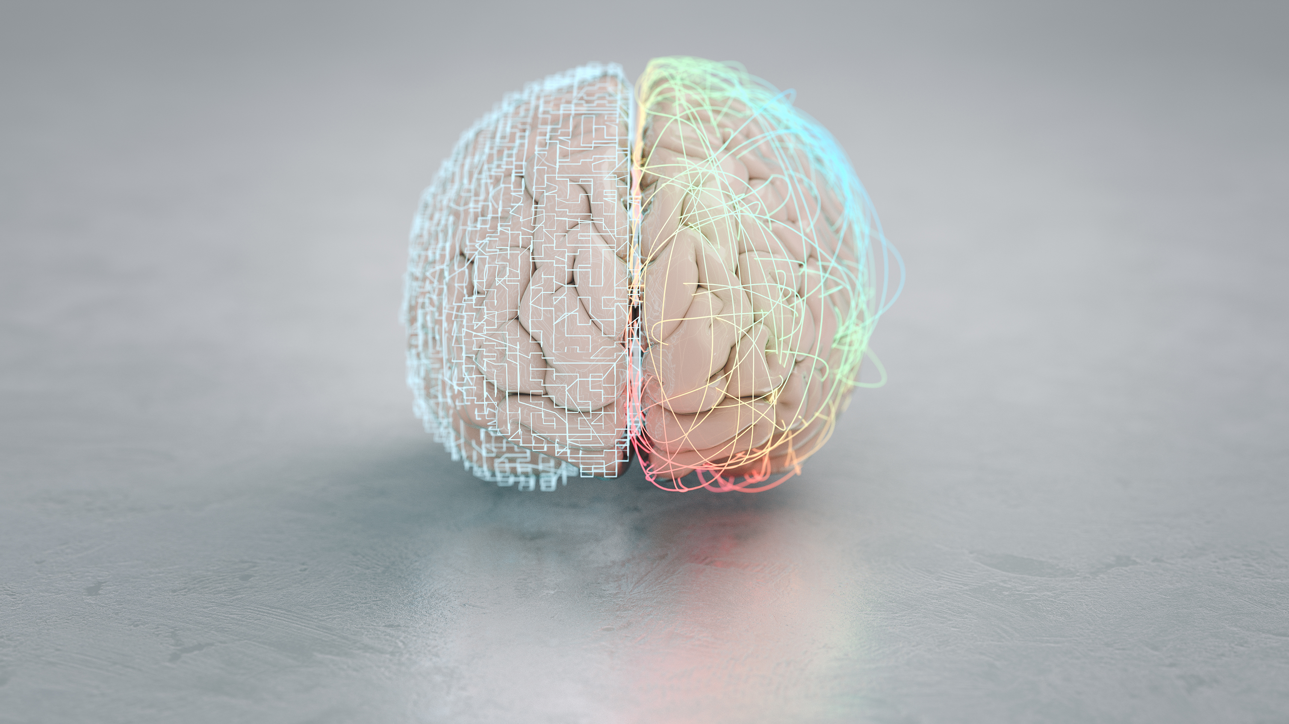
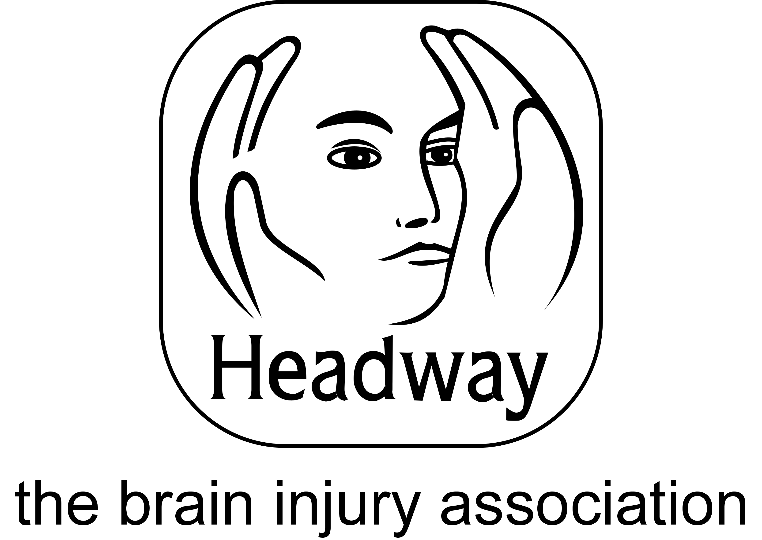
AI and acquired brain injury
Tamsin Keyes
Publications and Research Manager,
Headway – the brain injury association

Slide 17
How the brain can be affected
Stroke
Trauma (e.g. road traffic collision, fall, assault)
Hypoxia/anoxia
Meningitis
Brain abscess
Brain tumour
Carbon monoxide poisoning

Slide 18
Symptoms of brain injury
Memory problems
Executive dysfunction
Headaches
Hormonal imbalances
Fatigue
Visual problems
Mobility problems
Difficulties with processing information

Slide 19

Definition of AI
Definition of AI
“…the capability of a computer system to mimic human-like cognitive functions such as learning and problem-solving.”

Slide 20
Types of AI
Types of AI
Self-driving cars
Smart home technologies
Bots and digital assistance
Health data analysis
Social media

Slide 21

Real life examples
Real life examples
from our online
communities
ChatGPT and Grammarly
Alexa
Symptom tracker
Treatment plans
Recommendations for adaptations

Slide 22

Ethical considerations
Data protection
Privacy
Legislation
Equality of access
Realistic expectations and limitations

Slide 23

Thank you for listening!
tamsin.keyes@headway.org.uk
www.headway.org.uk
Helpline: 0808 800 2244 / helpline@headway.org.uk

Slide 24
Microsoft AI and Copilot
Michael Vermeersch, Microsoft

Slide 25


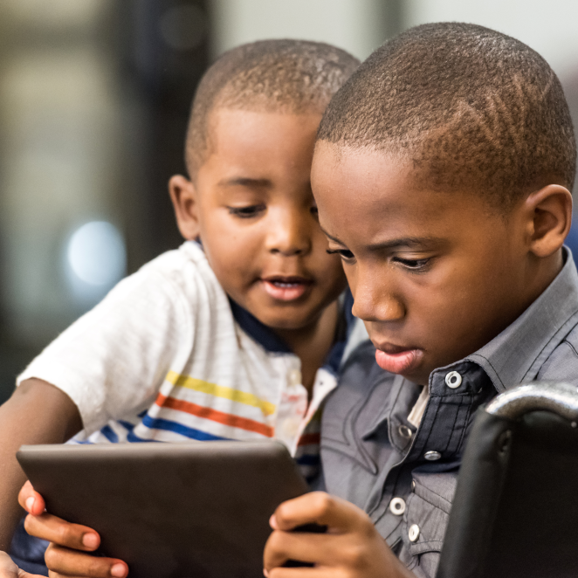

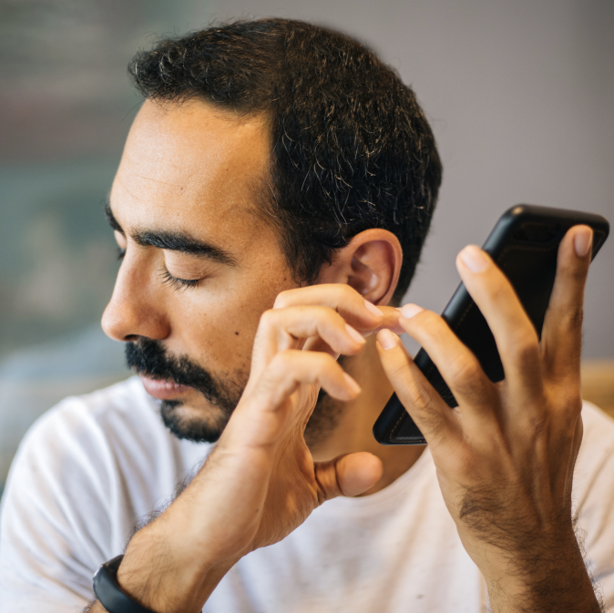
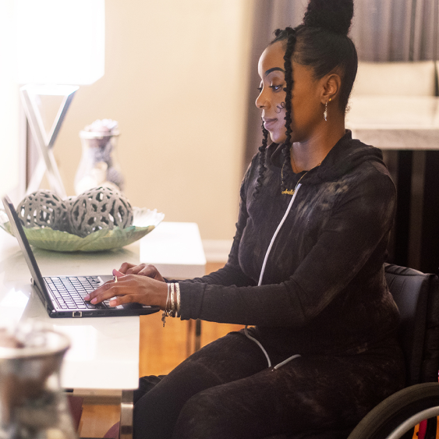


Bridging the disability employment gap with AI and Copilot
Michael Vermeersch
Accessibility Go To Market Manager
April 2024
Notes:
Welcome to the session Removing barriers to accessibility with Artificial Intelligence and Copilot.

Slide 26

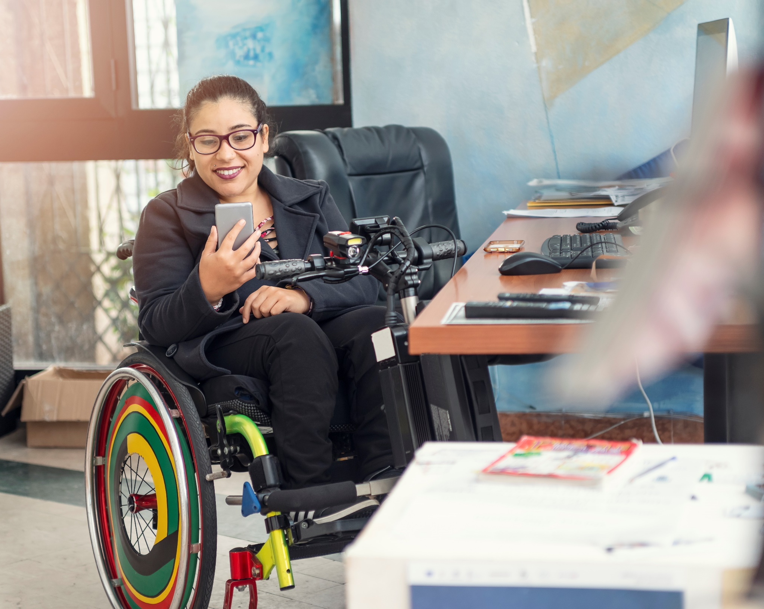
The opportunity:
AAA
See also: Accessibility Blueprint - Horizon 1 - Adopt
Attract and Retain Talent
9.5M people of working age in the UK who have a disability, approximately 23% of the working-age population.
83% of us are likely to gain a disability during our working lives.
Enhance productivity
72% of employers see an increase in overall workforce productivity after offering adjustments

Slide 27
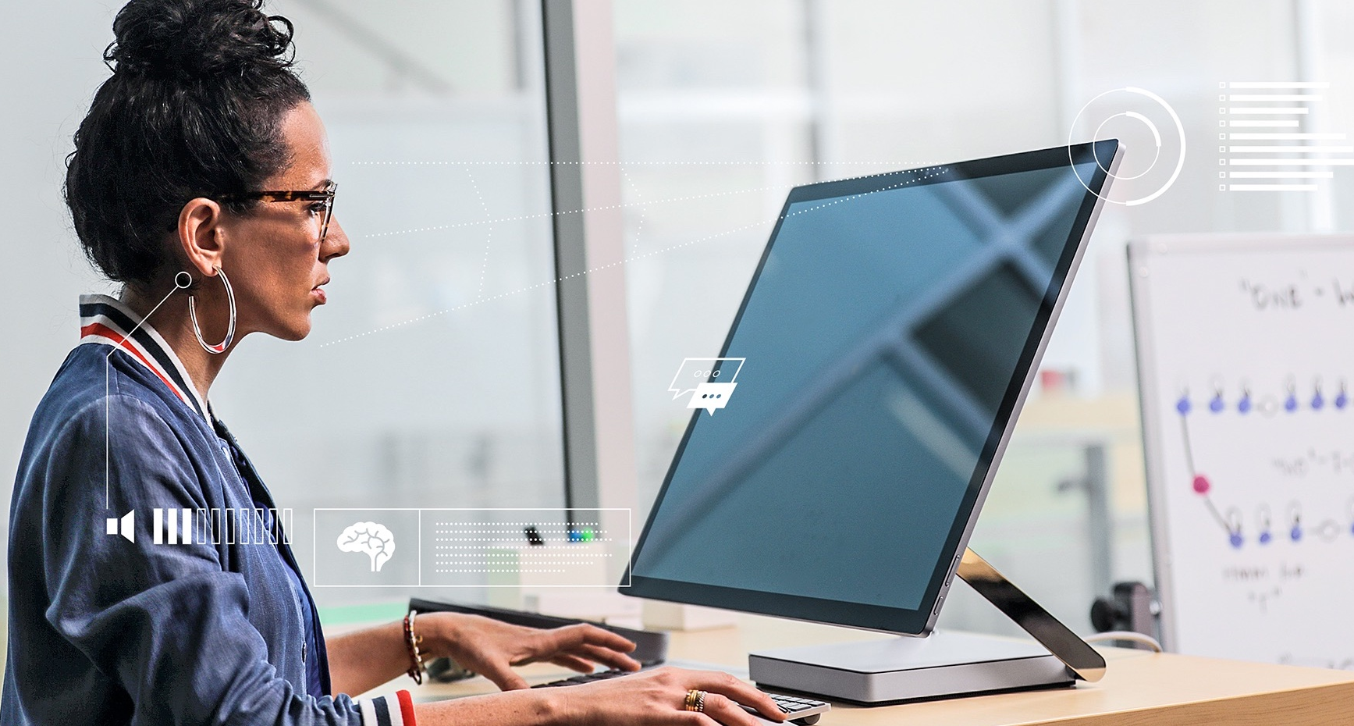
AI amplifies human capability
Image recognition
Speech recognition
Natural language interaction
Large Language Models
Notes:
AI accelerates innovation and opens the door to a new wave of possibilities. We believe that AI can amplify human capability, and that it will improve the way people with disabilities interact and leverage technology in their daily lives.
The term AI refers to a broad range of technologies that can:
Perceive images and sounds, and understand them
Learn from these inputs and interactions and get better over time
Reason over large amounts of data to identify patterns
Together these represent a huge shift in technology---we used to have to learn how to use machines, but now they can learn from us.
Despite all this progress and potential, AI is probably one of the least understood technologies. And that isn’t surprising because AI isn’t something you can see or touch, and you may not even realize you are using it. In fact, most of us are probably relying on technology that uses AI every day, without even knowing it.

Slide 28

AI and Accessibility
“Artificial intelligence and the emergence of cognitive services in the cloud led to a reimagining of assistive technology and led to increased focus on inclusive design.
Generative AI is likely to create a similar moment but this time the inclusion is likely to be via mainstream technology across industries”
Notes:
Before we go a little bit deeper in this I want to look at this phrase here. This phrase nicely cuts off for me where we were and where we are. Where we were with artificial intelligence has that first part and I'll read it for you: artificial intelligence and the emergence of cognitive services in the cloud led to a re imagining of assistive technology and led to increased focus on inclusive design so we had that stuff going on with artificial intelligence that already helped us with regards to recognising things, reading stuff for us, all that kind of stuff and that already bridged a lot of gaps and was already part and parcel of innovations in assistive technology . The second part: generative AI is likely to create a similar moment but this time the inclusion is likely to be via mainstream technology across industries. What does that sentence actually mean? Whereas the first sentence makes it very specific to assistive technology and how we interact with technologies, here it is actually saying something about how inclusion is going to happen within mainstream technology not just at the interface, but across everything. Not just as an application which will help you read stuff better or remove gaps with regards to recognising stuff like images and so on. Here is something which is going to be very pervasive both from a technology perspective but also from a use case perspective and this is very exciting and this can bridge many, many gaps.

Slide 29
AI/Copilot and accessibility - Observations
Guidelines & Standards
New user & accessibility Experiences
Augment existing technology?
E.g. WCAG:
Perceivable, Operable, Understandable, Robust
How relevant are they still?
How does it impact the experience of people with disabilities?
Do new or other experiences become more useful?
Notes:
We already had a lot of early trials with customers. There were observations that came out of this and I put them in three pillars. First pillar: guidelines and standards; we know we have those an example of this is WCAG an accessibility standard. What we saw in those trials is that we could ask the question how relevant are standards? I will get to the answer much later but I want you to think about that. The second pillar: new user and accessibility experiences. Thanks to AI the questions that we saw answered there was how does it impact the experience of people with disabilities? Third pillar is around existing technology and how artificial intelligence is augmenting it. Are there new or other experiences because of this which are much more useful than the traditional experiences? Are we having innovation?

Slide 30
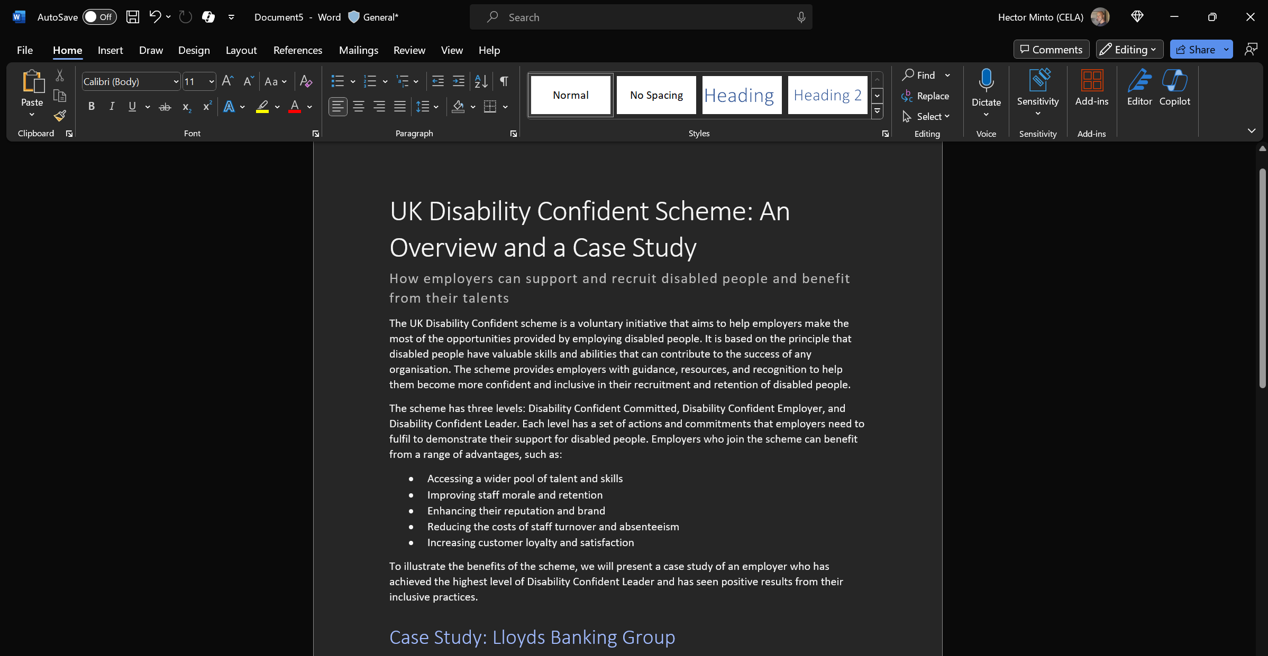
Example Word

Slide 31
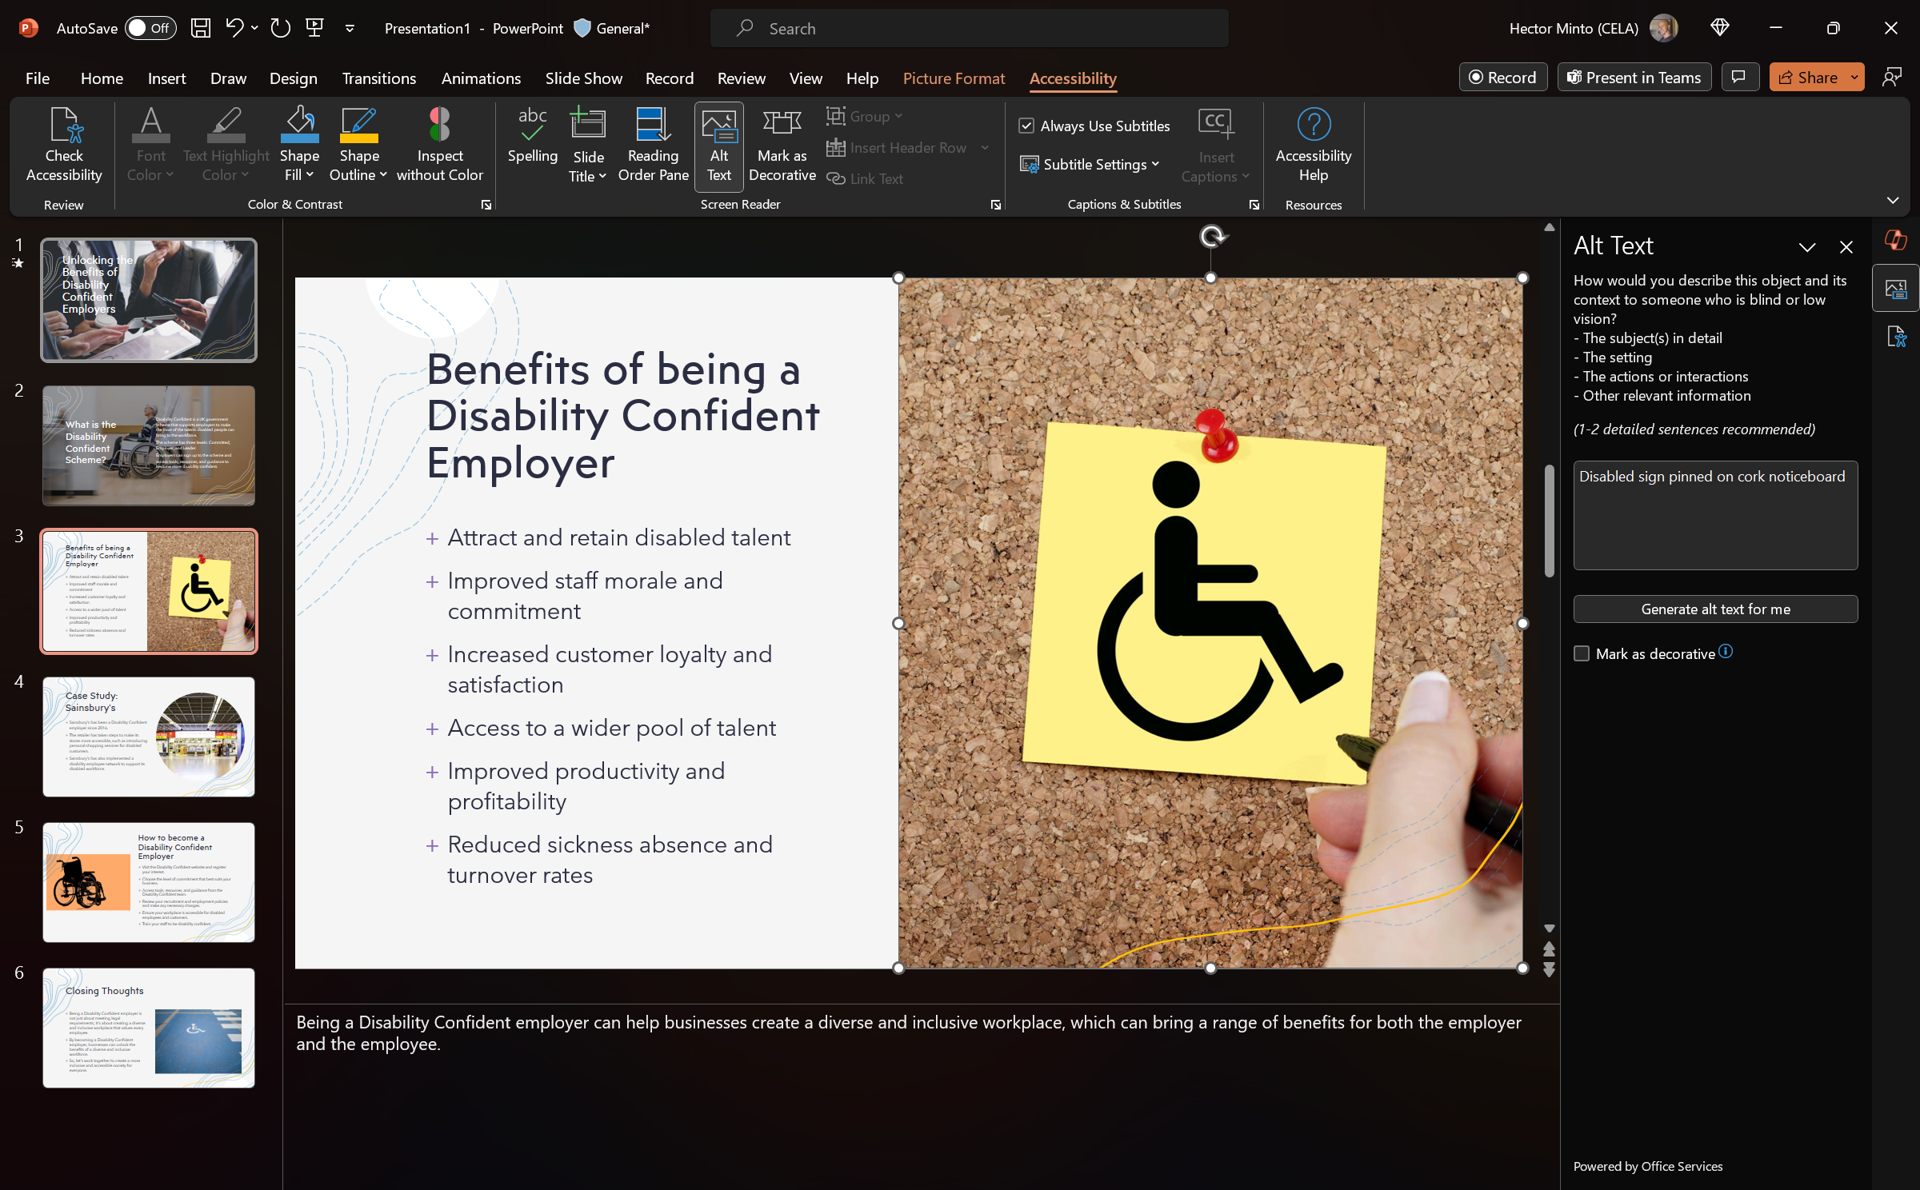
Example
PowerPoint

Slide 32



PowerPoint copilot (web)
Disability Segment
Vision
Hearing
Neurodiversity and learning
Mental Health
Mobility
Creation of visual content based on text prompts or Word documents
N/A
Ability to summarize a presentation into simple language
Creates alongside people reducing cognitive load and aiding creativity
Can help with mobility load through voice to text
Use case
Inclusive Design
Language:
Available in 72 languages
Location:
Available in most countries
Online versions require internet connectivity
Enabling the easy creation of visual content based on text prompts or Word documents with benefits across Vision disabilities
Notes:
Copilot in PowerPoint helps you turn your ideas into stunning presentations. As your storytelling partner, Copilot can transform existing written documents into decks complete with speaker notes and sources or start a new presentation from a simple prompt or outline. Condense lengthy presentations at the click of a button and use natural language commands to adjust layouts, reformat text, and perfectly time animations. Here are some example commands and prompts you can try:
Create a five-slide presentation based on a Word document and include relevant stock photos.
Consolidate this presentation into a three-slide summary.
Reformat these three bullets into three columns, each with a picture.

Slide 33
AI/Copilot: Accessibility – Summary of our trials
Guidelines & Standards
New user & accessibility Experiences
Augment existing technology
AI & Copilot can make user experience and content more accessible with and in the control of the user
Discoverability of (accessibility) features and help with content creation, filling gaps, augments human experience and capability
Building on proven use cases, innovative and inclusive scenarios are just around the corner waiting to be discovered.
Notes:
In summary: we asked questions against these pillars and seeing those examples and those use cases here are some of the answers that we could shape against those pillars. As far as guidelines and standards are concerned - they are important of course – Here we have a 24/7 virtual assistant helping you with a better user experience as well as with content and you are in full control of this. Will you still care about standards? We have seen examples where artificial intelligence can make features and that includes accessibility features more discoverable and help you implementing those features and help you also with content creation and that can fill gaps and that can augment our human experience and our human capability generating new user and accessibility experiences. Lastly when you put all these use cases together suddenly you get to completely new scenarios where you can bring in data from different applications in different use cases generating new opportunities augmenting existing technology allowing to do much more, faster as well as new things.

Slide 34
Appendix

Slide 35








What is accessibility?
Designing products, services, and environments with and for people with disabilities
Accessible technology
allows people with disabilities
to more fully participate in our economies and societies
1+ billion people
in world with disabilities, many who benefit from assistive technology
Disability
can affect any of us at any time
Permanent
Situational
Temporary
Vision
Hearing
Neurodiversity
Mental Health
Mobility
Speech
Notes:
What do I mean with accessibility?
It is about making sure that everyone gets a great experience and for us that includes making sure that our products, services, and environments have been designed not only for, but also with people with disabilities.
Why does that matter? There is over a billion people with disabilities on the planet. That is a lot of talent, that is a lot of market share that we should not ignore.
Plus, if you appreciate that only 17% of us are born with a disability and ultimately… unless we die in full health, we will gain a disability. The average age of gaining a disability is 46. As we live longer, and the expectation is there to live and work longer it is key that we focus on this.
Ultimately as per the social model of disability, we are disabled by barriers we face and accessible technology can remove those barriers and allow disabled people to participate more fully.
Just in case you wonder we cover a broad spectrum when we discuss accessibility listed here, vision, hearing, neurodiversity, mental health, mobility, and speech.

Slide 36


Generative AI x Accessibility
Disability Segment
Vision
Hearing
Neurodiversity and learning
Mental Health
Mobility
Accessing web information (that might not be accessible) in one accessible place
Foundation models:
Using natural language to generate visuals
Image analysis modality, allowing user to query visuals
Summarization of online meetings and voice through text
Summarization
Plain language conversion
Authoring (text and code generation)
Foundation models:
Generation of visuals for ease of understanding data and content
Decreasing cognitive load (one stop for information pulled from various sources, simplification of data and information through analysis)
Reducing shifting between multiple tabs, allowing for easier navigation (several copilots allow for voice control and input as well)
Reducing mobility load by autocompleting code of generating text
Accessibility
Use Case
Platform:
Accessibility must be built into platforms/software to be accessible for disabled users, with considerations for assistive technology such as screen readers.
Output:
AI can inherit and amplify biases, leading to unfair outcomes such as stereotyping, exclusion, marginalization, or denial of services. For example, LLMS and foundational models can generate text or images that portrays people with disabilities as victims, sufferers, or burdens, or that uses offensive or derogatory language to describe them.
Exclusion
Risks

Slide 37
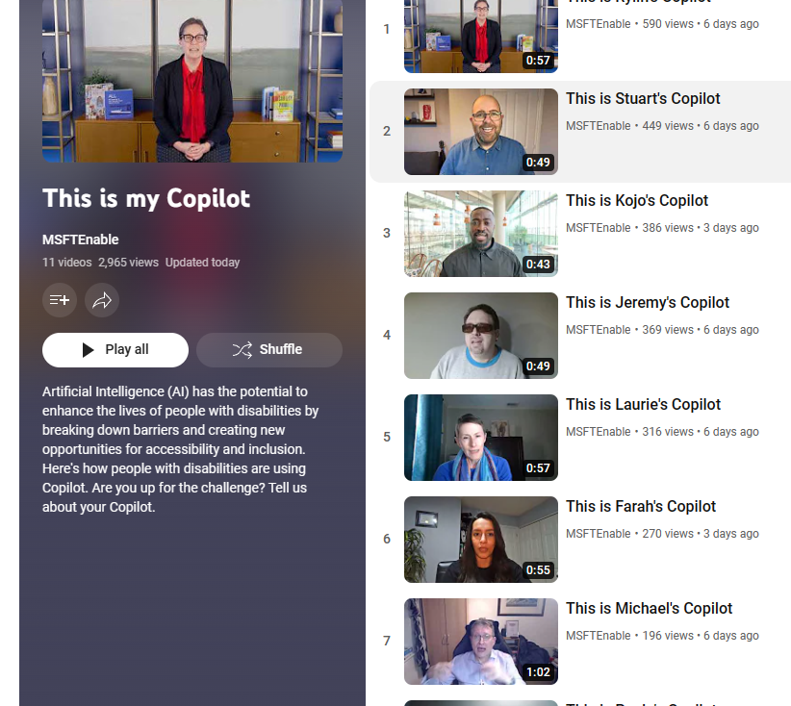
#ThisIsMyCopilot
This is my Copilot - YouTube

Slide 38



Accessible AI is Responsible AI
We are committed to the advancement of AI driven by ethical principles that put people first.
Fairness
Reliability and safety
Privacy and security
Inclusiveness
Transparency
Accountability
Accessible AI means to...
Build accessibly
Include representative data
Innovate
Our approach to responsible AI at Microsoft
Notes:
AI has been a big topic this year as we find ourselves at a historic intersection of opportunity and responsibility. People with disabilities have often been early adopters of new technology, and AI innovations will be no different. Examples:
Captioning
Audiobooks
Voice to text
AI has the potential to help people break down barriers and to make things quicker, easier, and even possible for people with disabilities. And there’s much more to come with the advancement of Generative AI. But the evolution of AI also comes with great responsibility and must incorporate a broad range of diverse human needs, capabilities, and experiences. We are committed to the advancement of AI driven by ethical principles that put people first. We apply our responsible AI principles to ensure our AI systems are developed in ways that warrant people’s trust.
Fairness
Reliability and safety
Privacy and security
Inclusiveness
Transparency
Accountability
These principles guide our approach to raise the bar on accessibility. To do this we focus on building accessibly, including representative data, and constantly innovating. And while we are always learning and improving, we know that AI systems must be inclusive of people with disabilities because when you build AI systems that reflect a wide spectrum of users, it will lead to better innovation for everyone.

Slide 39

Microsoft’s AI Principles
Accountability
Fairness
Transparency
Reliability & Safety
Fairness
Privacy & security
Reliability & Safety
Inclusiveness
Quality of service
Allocation of resources and opportunities
Minimization of stereotyping, demeaning, and erasing outputs
Reliability and safety guidance
Failures and remediations
Ongoing monitoring, feedback, and evaluation
Privacy Standard compliance
Security Policy compliance
Accessibility Standards compliance
Inclusiveness
Privacy & Security
Transparency
Accountability
Impact Assessment
Oversight of significant adverse impacts
Fit for purpose
Data governance and management
Human oversight and control
System intelligibility for decision making
Communication to stakeholders
Disclosure of AI interaction
Notes:
Here are some examples. It does not stop there. But just to give you some context against these principles.

Slide 40
Poll 2:
Now how confident do you feel giving AI technology a try – any change?
Very confident
Confident
OK with some devices/sites
Not confident
Not at all confident
NA

Slide 41
Open Q&A
Please use the Q&A window
Slides, transcripts and a recording of this online event will be made available

Slide 42
Free IT Support at Home and online
Factsheets, webinars available: abilitynet.org.uk
NEW: What is AI and how do I use it? factsheet: /AI-factsheet
Helpline: 0300 180 0028 – 9am to 5pm,
Monday to Friday
Free tech support for disabled and older people: www.abilitynet.org.uk/at-home
450+ tech volunteers who can solve IT issues either remotely or in person
Want to volunteer? /volunteer

Slide 43
Accessibility and inclusion training courses
Book in-house staff training and eLearning options for staff: visit /training
Save 10% on 2024 training courses: discount code AbilityNetWebinar10
Book now: www.abilitynet.org.uk/training
Embedding accessibility in your organisation: 2 May
PDF accessibility: 9 May
How to develop inclusive, accessible customer services: 15 May (GAAD week)

Slide 44
Keep in touch
AbilityNet newsletter: abilitynet.org.uk/newsletter
Accessibility services: abilitynet.org.uk/accessibility
Free webinars: abilitynet.org.uk/webinars
  What is Inclusive User Testing - Live from Google Accessibility Discovery Centre, London – 5 June
  Volunteers’ Week webinar – 6 June
  Dementia and simple tech tweaks that can help – Alzheimer’s Society 10 July

