Slide 1
Accessibility For Designers
Alice Taylor
Accessibility & Usability Consultant
January 2021

Slide 2
Welcome – Accessibility for Designers
Live captions
Slides, a transcript and recording
Q&A window for questions, chat window for general queries
Feedback form (questions or suggestions for future training)

Slide 3
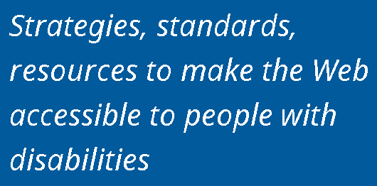
About AbilityNet

Slide 4
AbilityNet Online Training Series
Tues 4th Feb: How to create accessible documents and presentations
Weds 10th Feb: How to grow your accessibility maturity for HE / FE
Thurs 11th Feb: PDF accessibility
10% off any future AbilityNet online training courses this year with discount code AbilityNetTraining10 abilitynet.org.uk/training

Slide 5
Quick Recap
There is a free webinar available that gives an Introduction to Accessibility
Definitions
Moral, Legal, Business and Universal Reasons
Repeated Thursday 1st April
abilitynet.org.uk/training

Slide 6
Outline
We’re going to cover:
Inclusive Design
What is WCAG
Flexible Layouts
Contrast and Use of Colour
Non-Text Content
Visual Affordances
Movement and Interactive Content

Slide 7
Poll How confident are you with accessibility?
@Mark
Not at all confident
Somewhat confident
Moderately confident
Very confident

Slide 8
Inclusive Design
@Mark

Slide 9
Functional Definitions
Vision
Hearing
Motor
Cognitive

Slide 10
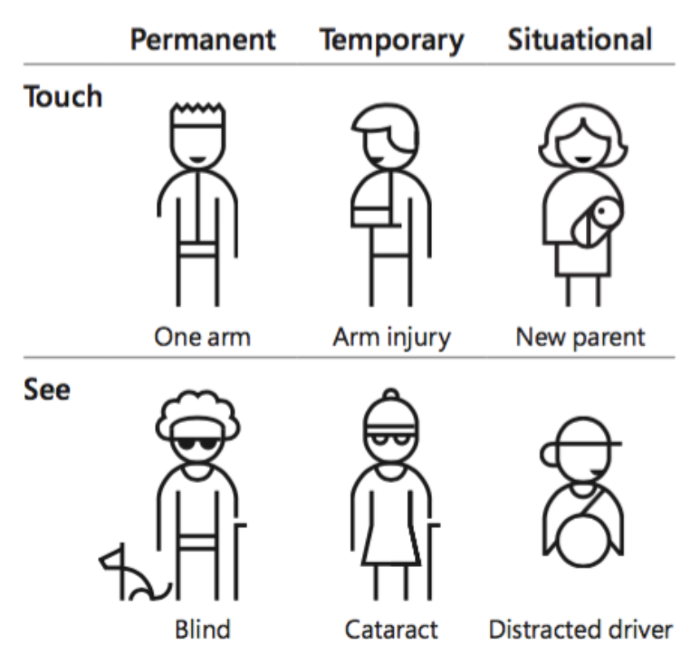
Inclusive Design
Our abilities can be affected by short term injuries or conditions.
Our abilities can also change in different environments and contexts.
Access needs can be permanent, temporary, or situational.
Microsoft Inclusive Design Toolkit

Slide 11
Web Content Accessibility Guidelines
@Mark

Slide 12
Web Content Accessibility Guidelines
Created by the WorldWideWeb Consortium (W3C)
Applies to all web content and markup
Current version is WCAG 2.1 (June 2018)
Principles, Guidelines, and Success Criteria (A / AA / AAA)
Technology agnostic

Slide 13
Accessibility Principles: POUR
Perceivable: Content is presented in ways that can be accessed by all
Operable: Content is presented in ways that can be operated by all
Understandable: Content is presented in ways that can be understood by all
Robust: Content is reliable and compatible with assistive technology and standards

Slide 14
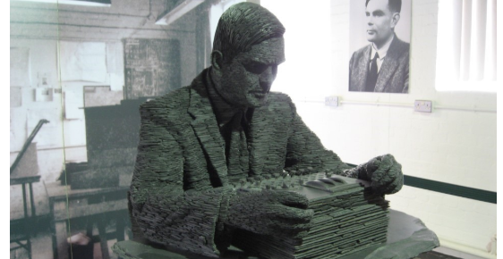
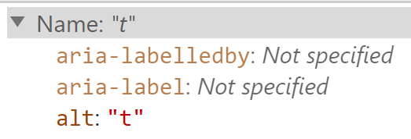
Example Success Criteria
The first success criteria Non-Text Content requires that “non-text content … has a text alternative that serves the equivalent purpose”.
This means images, icons, and graphs.
The example on this slide has the text alternative is “t” and does not serve an equivalent purpose.

Slide 15
WCAG 2.1 for Designers
Responsive Design
Orientation
Reflow
Text Spacing
Colour Palette
Non-text Contrast
Interactions
Pointer Gestures / Cancellation
Motion Actuation
Character Key Shortcuts

Slide 16
Flexible Layouts
@Mark

Slide 17
Poll Do you design your websites to work responsively?
@Mark
All the websites I design/work on are responsive
Most of the websites I design/work on are responsive
I’m not sure what responsive design is

Slide 18
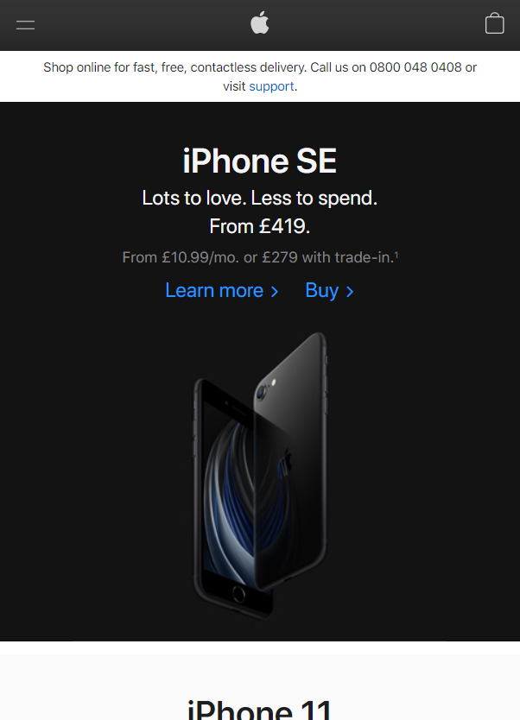
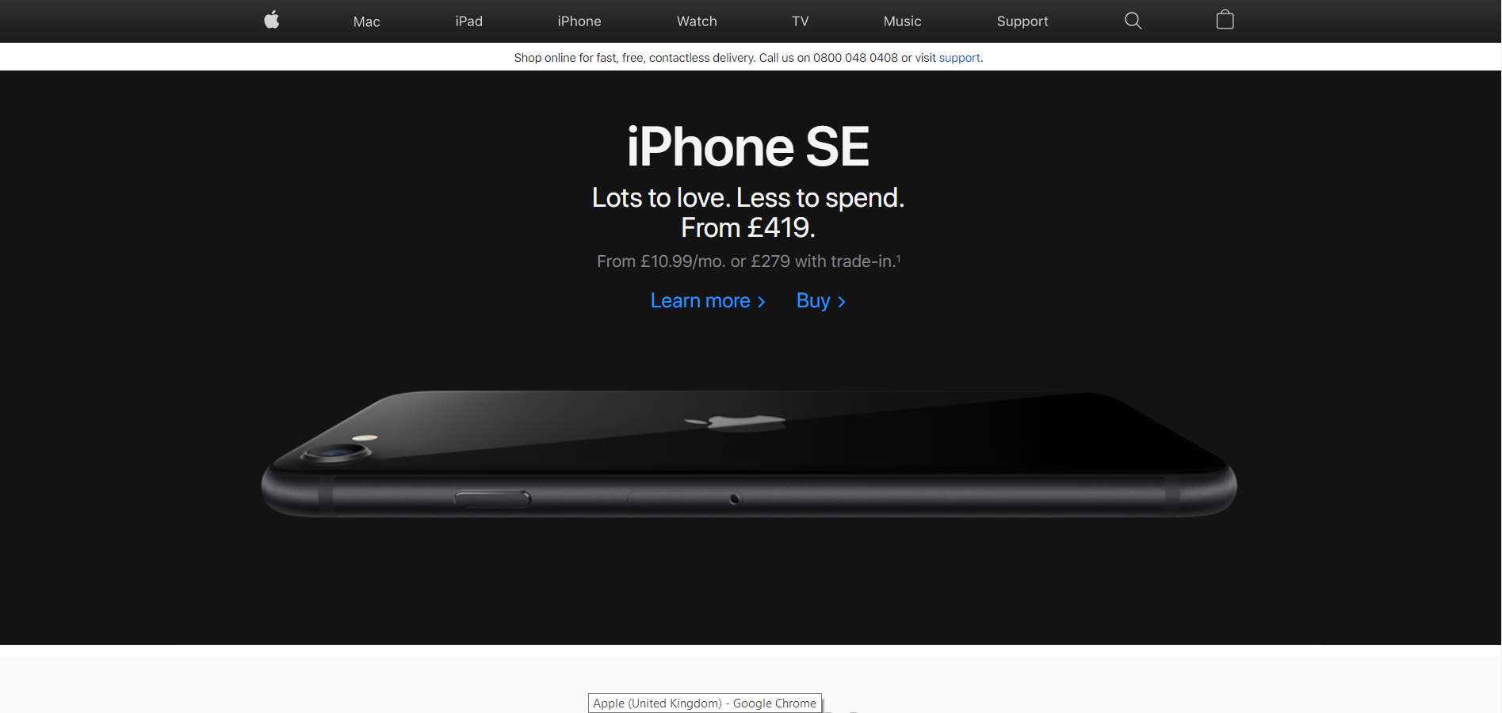
Responsive Design

Slide 19
Reflow
Generally speaking, Reflow means that you want content in a single column up to 400% zoom. Good example vs Bad example.

Slide 20
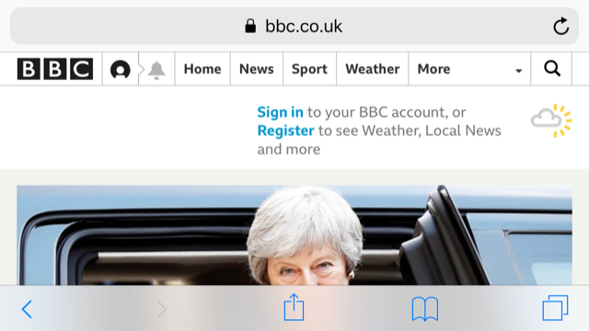
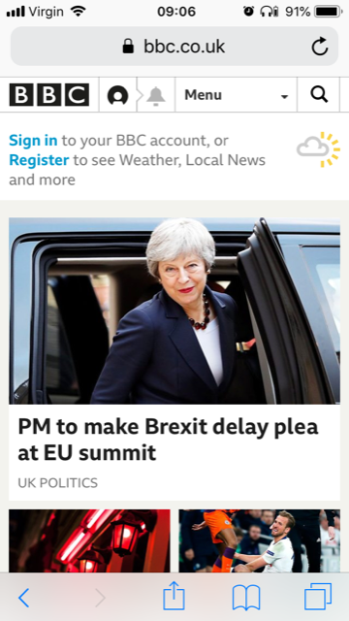
Orientation
Some aren’t conceptionally hard. But require work. For example, Orientation requires that everything works in landscape and portrait.

Slide 21
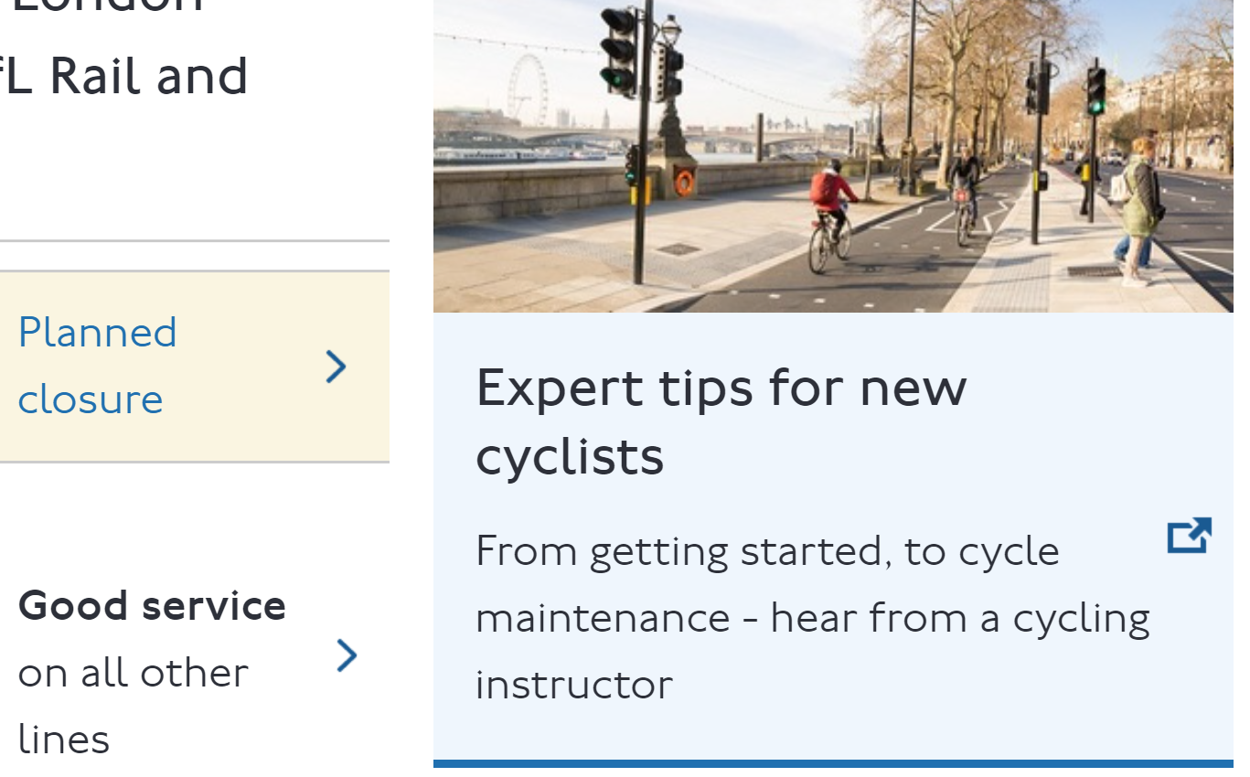
Resize Text
Except for captions and images of text, text can be resized without assistive technology up to 200 percent without loss of content or functionality.

Slide 22
Resize Text
Except for captions and images of text, text can be resized without assistive technology up to 200 percent without loss of content or functionality.

Slide 23
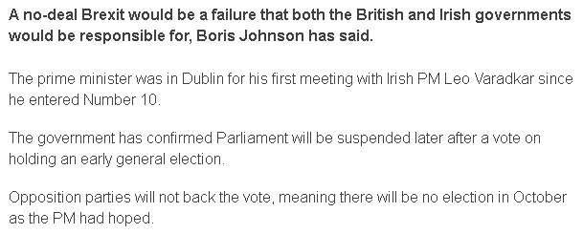
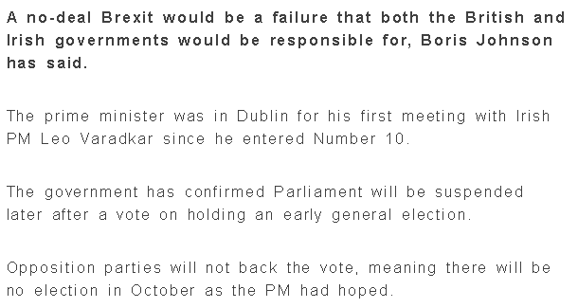
Text Spacing and Legibility
Support the following text style properties with no loss of content or functionality.
Line height to at least 1.5 times
Spacing following paragraphs to at least 2 times the font size
Letter spacing to at least 0.12 times the font size
Word spacing to at least 0.16 times the font size.
Test with bookmarklet, and here is a bad example.

Slide 24
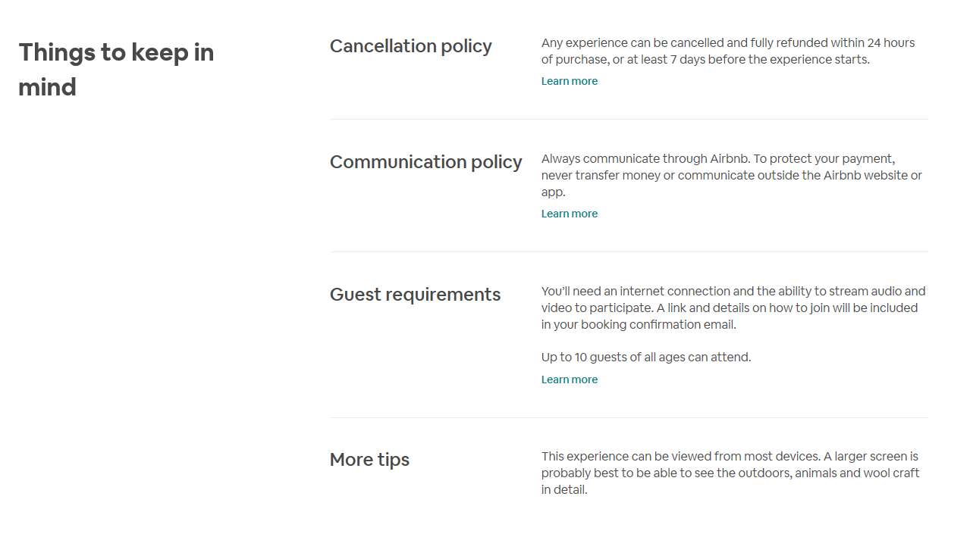
Layout of Page

Slide 25
Font Choices
Hello
Hello
Hello
Hello
Hello
Hello
Hello
Hello
Readability
Sans serif and serif
I and l
Handwriting fonts?

Slide 26
Navigating
Ensure the navigation is in the same relative order on each page
Ensure components that have the same functionality within a set of pages can be identified consistently

Slide 27
Flexible Layouts Summary
Shouldn’t require a lot of extra work
Should be built into the process already when designing and building responsive websites
Important not to restrict and allow users to customise – use relative units

Slide 28
Questions? Break 1
@Mark

Slide 29
Contrast and Use of Colour
@Mark

Slide 30
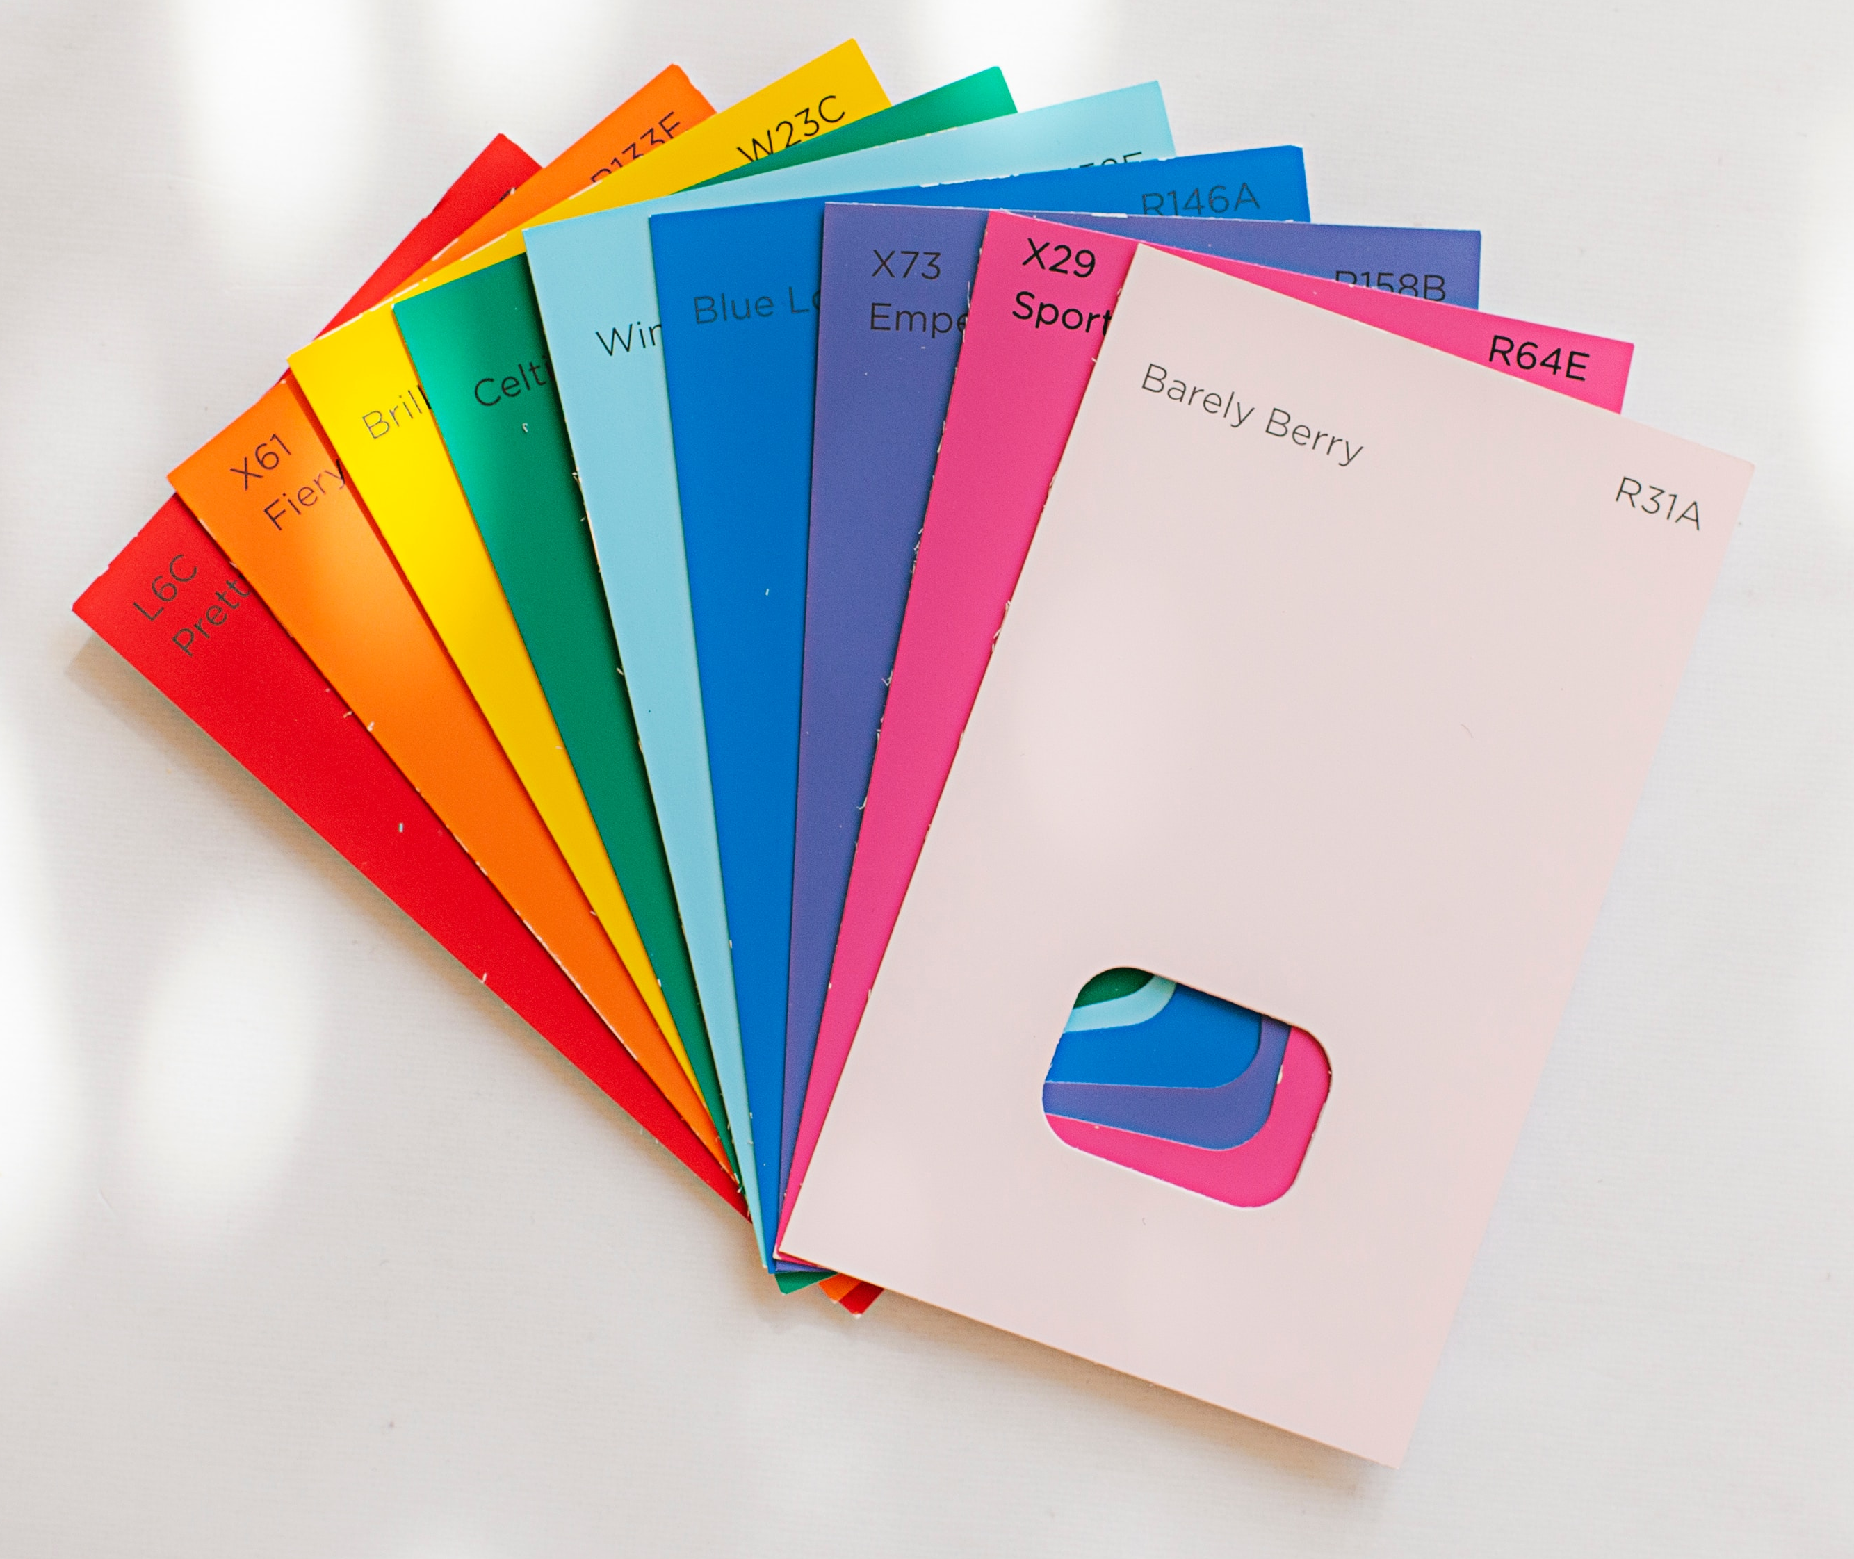
Contrast and Use of Colour
Not all users can perceive colour equally
Does not imply avoiding using colour
All users must be able to perceive the content on the page

Slide 31
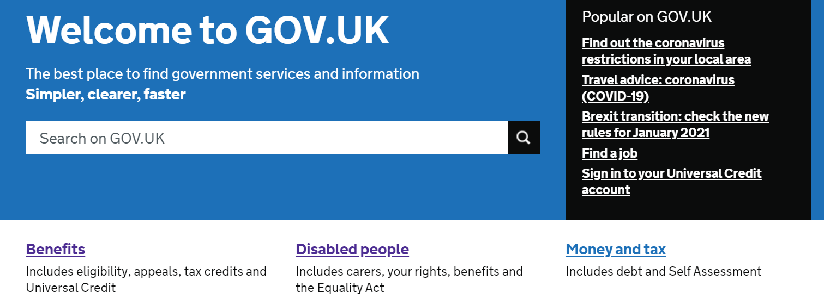
Text Contrast
Text must have a contrast ratio of at least 4.5:1 and large text must have a contrast ratio of at least 3:1
Inactive components, decorative elements and logos are exempt (but brand colours are not)

Slide 32
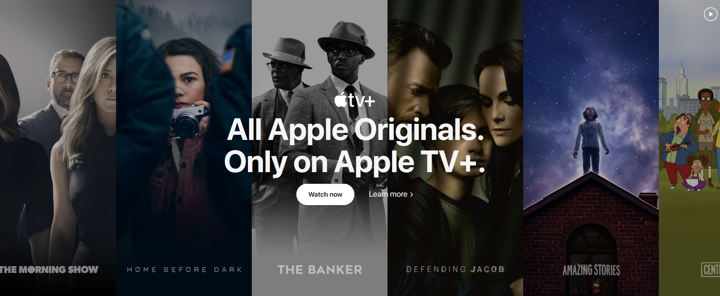
Contrast Considerations
Good to test at design stage - prototypes can be checked before they go live
Inconsistent background colours can cause contrast issues
Pay attention to text displayed over images

Slide 33
Non-Text Contrast
UI and graphical objects must be at least 3:1 ratio
Selection states (e.g. on tabs)
Custom focus indication
Boundaries and backgrounds
Graphs and icons
Understanding Non-text Contrast

Slide 34
@Mark
Poll Would this fail non-text contrast?

Slide 35
‘Required to understand/identify’

Slide 36
Custom Focus Indicator
:focus
Default focus is exempt
If you remove the default outline, provide alternative styles
Must meet a contrast ratio of 3:1

Slide 37
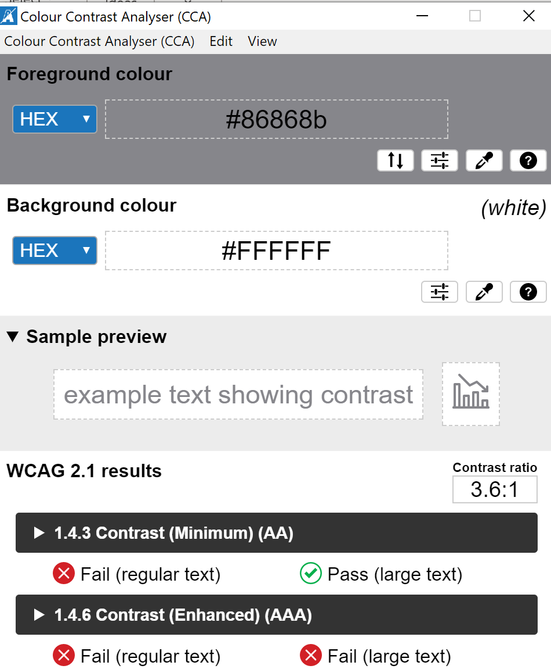
Colour Contrast Tools
Colour Contrast Analyser allows for point and click checking using a colour dropper
Sample preview shows the appearance for text and data charts
WCAG 2.1 Compliance Summary including ratio
Colorsafe and Contrast Finder

Slide 38
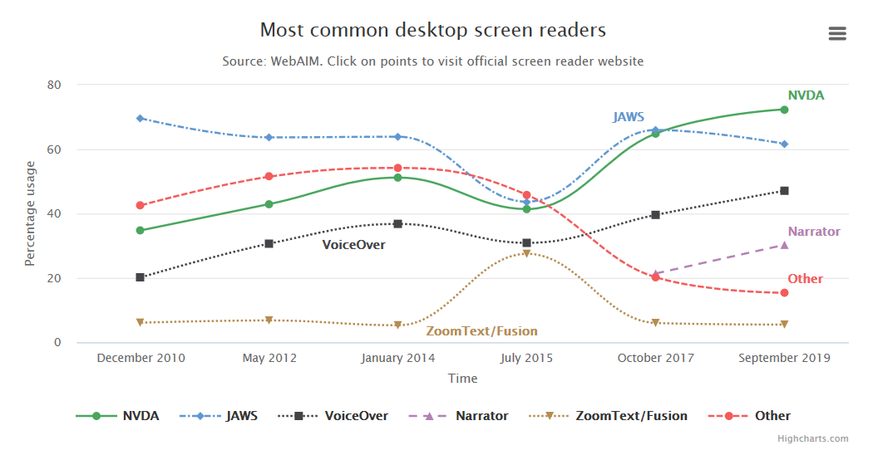
Use of Colour
Color must not be used as the only visual means to:
Convey information
Indicate an action
Prompt a response
Distinguish a visual element

Slide 39
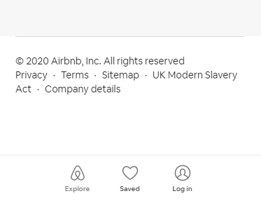
Use of Colour

Slide 40
@Mark
Poll Is this an accessible use of colour to convey the interactive button?

Slide 41
Use of Colour: Accessible Design
Fails
Passes
Colour alone conveys action
Colour and text cues convey action
CANCEL
SUBMIT

Slide 42
Use of Colour: links
Would this link pass ‘use of color’?
Links must not use colour alone to distinguish from surrounding text…
Unless the link has 3:1 contrast with surrounding text AND there is an additional state on hover/focus (for example, an outline or underline)

Slide 43
Use of Colour: links
Underlined by default is preferred!

Slide 44
Other Senses
Ensure instructions provided for understanding and operating content do not rely solely on sensory characteristics of components:
Shape
Size
Location
Orientation
Sound

Slide 45
Questions? Break 1
@Mark

Slide 46
Non-text Content
@Mark

Slide 47
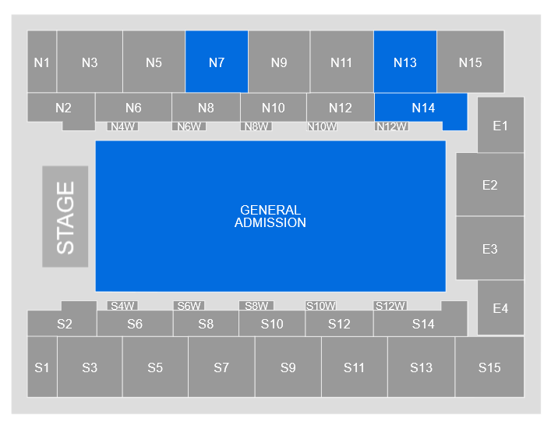
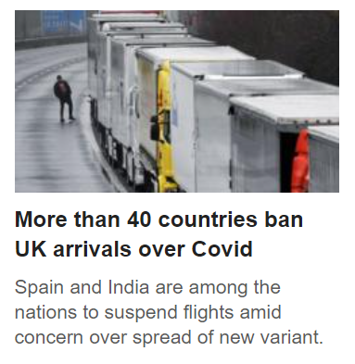
Non-text Content
All non-text content that is presented to the user has a text alternative that serves the equivalent purpose.
Functional images
Decorative images
Informative/Complex images
Alt decision tree

Slide 48
Images of Text
Avoid images of text unless it cannot be avoided for presentation purposes
(e.g. company logo)
Ensure a suitable text alternative
Contrast requirements apply
Colour/Size cannot be customised

Slide 49
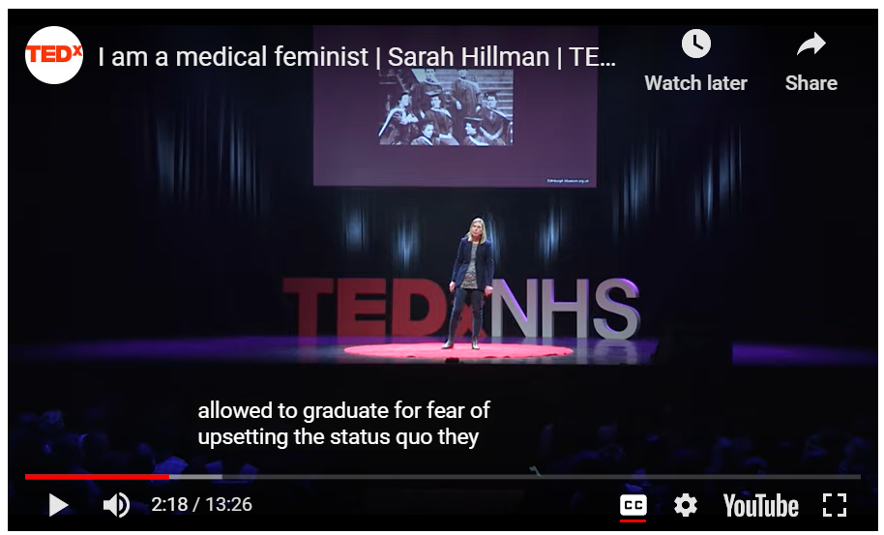
Multimedia
Providing access to comparable information via multiple formats:
Captions
Transcripts (static, descriptive, interactive)
Audio Description (example)
W3C Making Audio and Video Media Accessible

Slide 50
Visual Affordances
@Mark

Slide 51
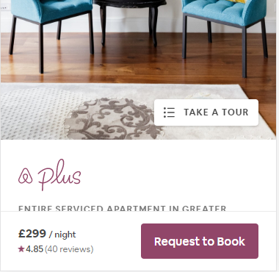
Visual Affordances
An affordance in design provides a clue about what something is and how to interact with it
These affordances should be reflected in the mark up

Slide 52
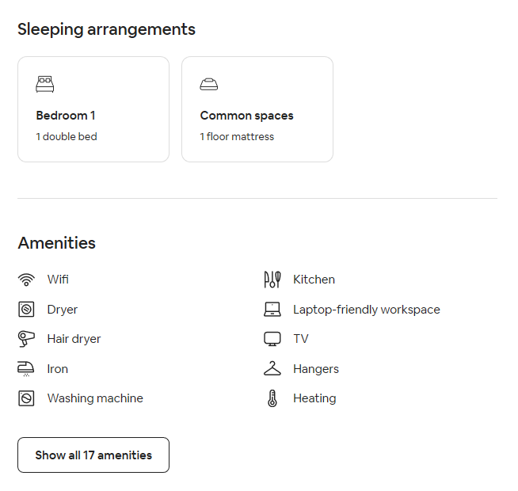
Is ‘Bedroom 1’ a button?

Slide 53
Behaviour and States
Behaviour and state should be clear programmatically, as well as visually
Is it active? Disabled? Hovered? Focused? Error?
Must also meet colour contrast requirements

Slide 54
Is ‘Schedule for later’ disabled?

Slide 55
@Mark
Poll What is clickable?

Slide 56
Icons
Icons should be consistent, intuitive and usable.
Is it clear what the icon represents?
Does it have an appropriate text alternative?
Does the icon have alternative meanings?

Slide 57
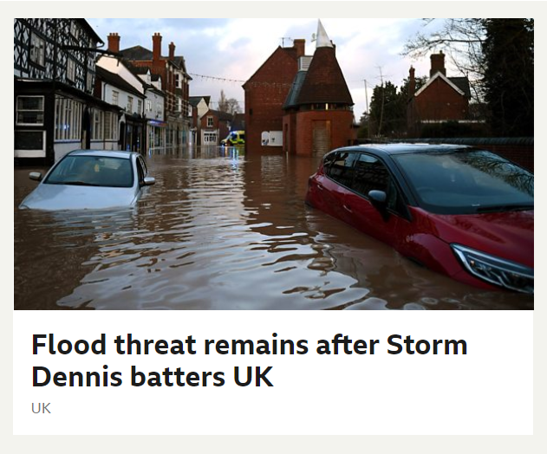
Hidden Affordances
Think about what the design is not saying
What should a screen reader user hear first?
What does ‘UK’ imply?
Hidden text can be added for screen reader users

Slide 58
Questions? Break 2
@Mark

Slide 59
Movement and Interactive Content
@Mark

Slide 60
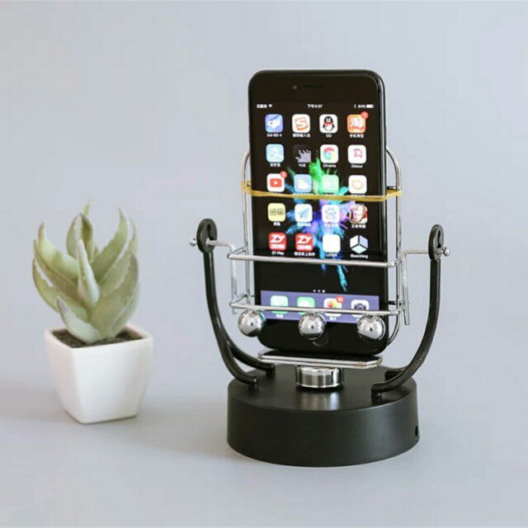
Interaction
Pointer Gestures: Do not rely on gestures (swiping, pinch and zoom, etc.). Provide button alternatives.
Pointer Cancellation: Do not trigger anything on the down event. Wait for the up event.
Character Key Shortcuts: Do not use single alphanumeric, punctuation, etc., keys for behaviour.
Motion Actuation: Do not have functionality that can only be accessed from motion. Allow user to disable the functionality even when there are alternatives.

Slide 61
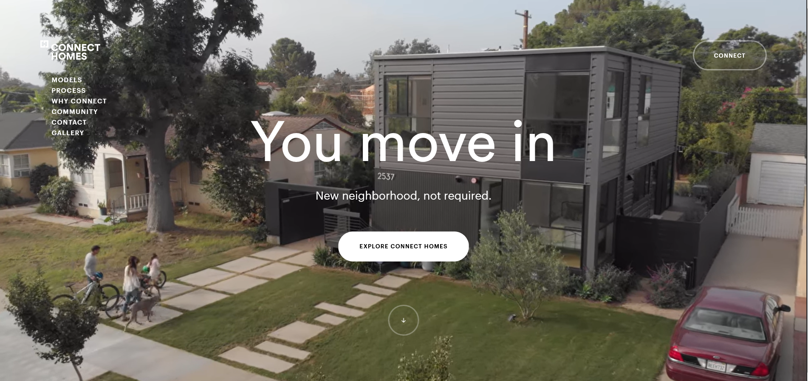
Movement
Automatically moving, blinking or scrolling content can be paused, stopped or hidden by the user.
Applies to content that lasts more than 5 seconds
Automatically updating content can be paused, stopped, hidden or customised by the user.
No 5 second limit

Slide 62
Background Video
Must have pause button
Text over video - 4.5:1 ratio
Shouldn’t contain important information

Slide 63
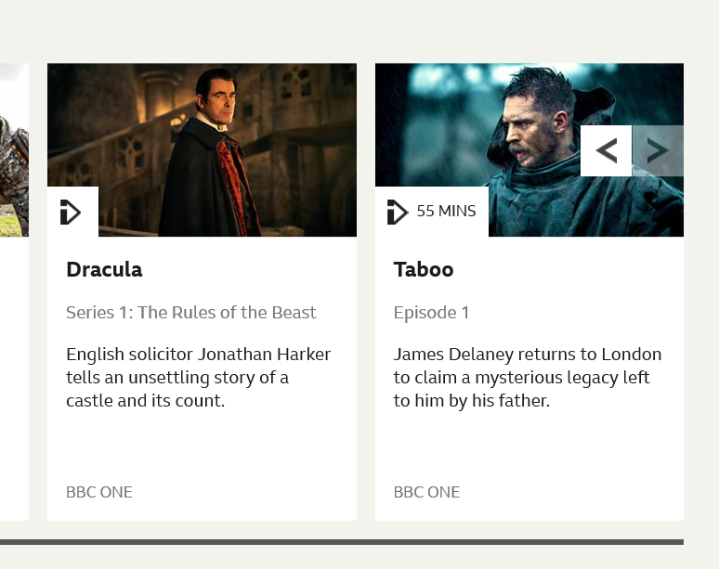
Carousel
A common pattern is for a carousel that rotates through multiple slides.
Do not assume everyone is using mouse or touch screen
Auto-playing carousels can be distracting
Some users may need more time to read the content
Accessible Autoplaying Carousel

Slide 64
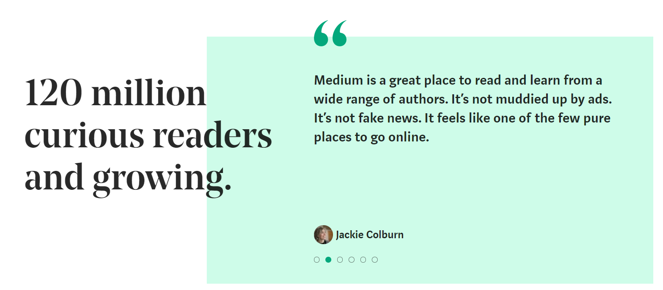
@Mark
Poll What is this autoplaying carousel missing?

Slide 65
Flashing Content
People who are photosensitive can have seizures triggered by repeated flashing.
Avoid flashing content or ensure it does not flash more than 3 times per second
Ensure size is less than 25% of 10 degrees of the angle of view and use a tool to measure content (e.g. PEAT)

Slide 66
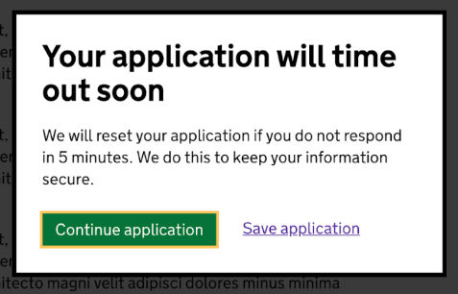
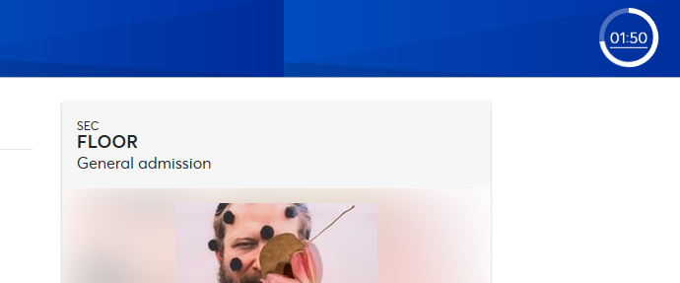
Timing
Warn users about timeouts
Inform them how long before they occur
Give the option to disable the time limit or extend the current session.
Exemptions apply for real-time or essential timing conditions.

Slide 67
Movement Summary
Ensure moving, blinking or scrolling content can be stopped or paused or hidden if it lasts longer than 5 seconds
Ensure auto-updating content can be stopped, paused or hidden
Avoid flashing content, or ensure it does not flash more than three times per second
Warn users if there is a time limit

Slide 68
Recap
We’ve covered a lot of ground! We’ve talked about:
Inclusive Design
What are WCAG
Flexible Layouts
Contrast and Use of Colour
Non-Text Content
Visual Affordances
Movement and Interactive Content

Slide 69
Questions? Break 1
@Mark

Slide 70
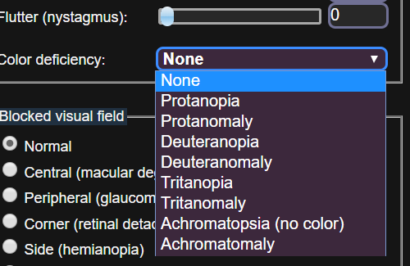
Useful Tools
Colour Contrast Analyser - Win/macOS application
Stark - Sketch / XD Plugin
Photoshop Colour Blindness Filter - Proof Setup
Accessible Colour Palette Builder - https://toolness.github.io/accessible-color-matrix/
NoCoffee Vision Simulator - Chrome Extension
A11y Focus Orderer – Figma Plugin
ARIA Authoring Practices - WAI-ARIA Authoring Practices 1.1 (w3.org)

